Slide 1
Illinois Workers’ Compensation Commission Update April 2021
Michael E. Rusin
Rusin & Maciorowski
10 South Riverside Blvd., Suite 1925
Chicago, IL 60606
merusin@rusinlaw.com

Slide 2
Illinois Workers Compensation Commission – Commission Personnel
10 commissioners, one of whom serves as the chairman.
For political balance, no more than 6 commissioners can be from one political party.
Three categories.
Three employer representatives
Three employee representatives
Three public representatives.
Appointed by the governor and confirmed by the Senate. 4 year terms.
Staggered - 5 change every 2 years

Slide 3
Illinois Workers Compensation Commission – Commission Personnel
5 commissioners terms expired 1/19/2021
Commissioner Thomas Tyrrell, an employee representative
Commissioner Stephen Mathis, a public representative
Commissioner Elizabeth Coppoletti, an employer representative
Commissioner Barbara Flores, a public representative
Commissioner Deborah Simpson, an employer representative
A sixth Commissioner, Douglas McCarthy, an employee representative, retired at the end of December, 2020.

Slide 4
Illinois Workers Compensation Commission – Commission Personnel
Changes expected, as Governor did not immediately reappoint the commissioners whose terms expired 1/19/21
Labor opposed Coppoletti and Simpson. Appointments due by 3/19/21. Appointments made 3/19/21
Pritzker reappointed Commissioner Thomas Tyrrell as an employee representative. Complete term of retired Commissioner McCarthy - term ends 1/16/2023.
Reappointed Commissioners Barbara Flores and Stephen Mathis as public representatives.
Reappointed Commissioner Deborah Simpson as an employer representative.
Terminated Commissioner Elizabeth Coppoletti
Appointed Arbitrator Christopher Harris as an employer representative. No workers’ compensation background - Appointed an arbitrator on October 25, 2019.
Appointed Arbitrator Deborah Baker as an employee representative. Appointed an arbitrator in November, 2019. Worked as a petitioner’s attorney prior.
Terms of Commissioners Baker, Flores, Harris, Mathis and Simpson all run to January 20, 2025.

Slide 5
Illinois Workers Compensation Commission – Commission Personnel
Panel A – Public Member Maria Portela, Labor Member Thomas Tyrrell, Employer Member Kathryn Doerries
Panel B – Public Member Stephen Mathis, Labor Member Deborah Baker, Employer Member Deborah Simpson
Panel C – Public Member Barbara Flores, Labor Member Mark Parker, Employer Member Christopher Harris

Slide 6
Illinois Workers Compensation Commission – Commission Personnel
Labor Commissioner Baker is taking over the Chicago and Waukegan calls that were previously assigned to former Employer Commissioner Coppoletti.
Employer Commissioner Harris is taking over the Chicago and Springfield calls that were previously assigned to former Labor Commissioner McCarthy.
Panel B will be the most employer friendly panel
Panel C will be the most employee friendly panel

Slide 7
Changes at the Arbitration Level
33 budgeted arbitrator positions. 30 arbitrators appointed.
31 status calls – 13 in Chicago and 18 Downstate.
Large turnover at the arbitration level - Retirements and terminations
11 appointed in the last year
Training for those new arbitrators has been difficult because of the pandemic.
Most had prior workers’ compensation trial background.
Three are attorneys without significant prior WC experience.

Slide 8
Changes at the Arbitration Level
August 2020, Governor Pritzker appointed two new arbitrators:
Attorneys Jeanne Aubuchon, Gerald Napleton
December 2020, Governor Pritzker appointed three new arbitrators:
Attorneys Rachael Sinnen, Raychel Wesley and Bradley Gillespie.
No open status call positions when appointed.
Arbitrator Sinnen expected Chicago appointment.
Arbitrator Wesley and Arbitrator Gillespie projected to get downstate assignments.
There are currently not enough arbitrators to fill all the current arbitration slots.
30 of 31

Slide 9
Changes at the Arbitration Level
Arbitrator Sinnen has been assigned to Chicago
Took over call assigned to Napleton. Napleton was earlier moved to a downstate assignment in Zone 5 (Erbacci retirement).
Arbitrator Gillespie was given a downstate status call assignment. Assigned to Zone 3 including Bloomington, Peoria and Rock Island - formerly Arbitrator Granada.
Arbitrator Wesley has been assigned to Chicago – took over Baker call.
Chicago arbitration status call assigned to Arbitrator now Commissioner Harris is open. That call will be assigned on a monthly basis to an existing (likely downstate) arbitrator. For April 2021, Arbitrator Granada.

Slide 10
Changes at the Arbitration Level
33 budgeted arbitration positions. 30 arbitrators appointed. 3 positions are open.
Likely 1 or 2 will be promptly appointed.
Expiring terms end June 30, 2021:
Joseph Amarilio, Paul Cellini, Steven Friedman, Gerald Granada, Jessica Hegarty, Adam Hinrichs, Jeffrey Huebsch, Maureen Pulia, Melinda Rowe-Sullivan and Douglas Steffenson.
Most will be reappointed.
Arbitrators Amarilio and Friedman are both about 70 years old but neither seems interested in retirement.

Slide 11
Commission During Pandemic
Despite the pandemic, the Commission never closed its doors.
Many months the Commission had reduced schedule.
Early on frequent in person court appearances and live pro-se settlements.
For most of 2020 the Commission had a hybrid hearing schedule.
Pre-trials remotely versus WebEx and limited in person trials March to November.
Spike in COVID cases in November 2020, the chairman discontinued all in person hearings.
Reopening – Live hearings began February 1, 2021.
Hybrid schedule with a mixture of pre-trials and trials. Pre-trials are held during the beginning of an arbitrator’s trial cycle and trial dates are set at the end of the trial cycle.
The Commission has continued to have more in person hearings in 2021. The number of in-person hearing dates are still limited. Chairman posts calendar monthly.

Slide 12
Commission During Pandemic
Prior to the pandemic in Chicago, each arbitrator had a monthly status call date and 8 trial dates. On each trial date, the parties would appear before the arbitrator and request a pre-trial or a trial. Arbitrators generally would hear pre-trials first and start trials later in the day after pre-trials were completed.
With the pandemic, the basic schedule did not change but pre-trials were moved online through WebEx. No set schedule for pre-trials. Varies a lot by arbitrator.
The procedure for the downstate arbitrators was the same. Each downstate arbitrator had a status call and depending on the size of the status call, each arbitrator would have between 3-8 trial dates.
2021 calendar increased the number of trial dates for the arbitrators from 8 to 9. In Chicago, every arbitrator has a status call date and now 9 pre-trial/trial dates.
Downstate calls each arbitrator has a status call and a minimum of 3 but up to 9 pre-trial/trial dates

Slide 13
Commission During Pandemic
Chicago status calls:
Every month the arbitrators have a status call day and 9 hearing days.
In April 2021, the 9 hearing days are broken into pretrial days and trial days.
5 days are currently set for pre-trial conferences which are done via WebEx and 4 days are set for trial days.
Downstate calls:
Each of the arbitrators has a status call day
Then they have 2-5 pre-trial days and 2-4 trial days.

Slide 14
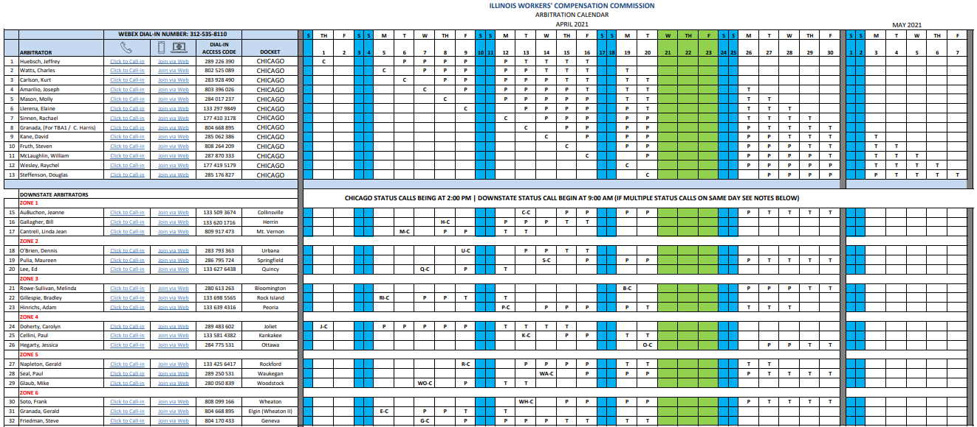

Slide 15
Commission During Pandemic
Downstate calls trial locations have been consolidated currently.
For Zone 1 (Collinsville, Herrin, Mt. Vernon), all trials are held in Collinsville.
For Zone 2 (Urbana, Springfield, Quincy) all trials are held in Springfield.
For Zone 3 (Bloomington, Peoria, Rock Island) all trials are held in Peoria.
For Zone 4 (Joliet, Kankakee, Ottawa) all trials are held in Chicago.
For Zone 5 (Rockford, Waukegan, Woodstock) all trials are held in Rockford.
For Zone 6 (Wheaton, Geneva, Elgin) all trials are held in Chicago.
Expect return to Downstate locations in July 2021

Slide 16
Commission During Pandemic
For hearings before the Commission:
All preliminary and review calls hearings are currently being held via WebEx.
All oral arguments before the Commission are being done telephonically.
This is true for both Springfield and Chicago oral arguments.

Slide 17
Commission Moving to new location
The Commission is moving, leaving the Thompson Center
The Commission is moving its administrative offices to 69 W. Washington Street, Chicago, IL 60602.
The Commission is moving its Chicago hearings/trials site
Basement of the Daley Center, 50 W. Washington Street, Chicago, IL 60602.
Expected late May 2021 to June 2021.
First move for the Commission in over 35 years.
Resided in Thompson Center since 1985.

Slide 18
Commission Expands Electronic Filing – CompFile Release 3
The Commission has always had a paper based filing system.
Multicolored paper required. Settlement contracts were pink, petitions for immediate hearing blue, etc.
Last summer – July, 2020, the Commission implemented the CompFile program. Settlement contracts became electronic only except for Pro se Settlements.
Standard procedure is for Respondent’s attorney to draft settlement contracts and route them to petitioner’s attorney for review, execution and submission to the Commission.
On April 21, 2021, the CompFile electronic filing program is being expanded greatly. The Commission expects all filing to be done electronically. Pending the start date the system will go down April 15, 2021 to April 20, 2021.

Slide 19
Commission Expands Electronic Filing – CompFile Release 3
The expanded CompFile program will require all Applications electronically.
Respondents will be required to file Appearances electronically.
The parties will be required to use CompFile to file motions, petitions, responses, briefs, etc.
All transcripts will become electronic.
Pro-se settlements will also be handled electronically - TBD
All motions (including motions for trial) will be required to be filed electronically and this will apply to the trial call of May 10, 2021 and after.

Slide 20
Commission Filings
Not surprisingly, Commission filings continue to be far reduced from past years.
2019 - Cases filed - approximately 37,500.
2020 - Cases filed was just under 32,000.
Case filings for 2021 projected at 30,000 for the year.

Slide 21
IWCC in transition
We expect the Commission to change its operations and case handling through 2021.
The Commission is regulated by the Illinois Workers’ Compensation Act, the Rules of the Illinois Workers’ Compensation Commission and case decisions. And politics.
The Illinois Workers’ Compensation Act has not significantly changed since the start of the pandemic.
The only significant change made was the creation of the rebuttable presumption in favor of “essential workers.”
That rebuttable presumption has been extended to June 30, 2021.
Case decisions really haven’t changed how the Commission operates.
There have not been any formal changes to the Rules of the Illinois Workers’ Compensation Commission.
The Chairman has the Rules for hearings on a monthly basis during the pandemic. Many of the rules and requirements set forth in the Rules have been modified and changed.

Slide 22
IWCC in transition
Under the Published Rules, cases can only be set for trial when on the status call every 3 months
Unless Petition for immediate hearing.
This rule is being routinely ignored.
The Chairman has encouraged and allowed extreme flexibility with respect to setting cases for pre-trial and trial.
Going forward, we expect any case can and will be motioned for trial at the discretion of the parties. We expect following the motion for trial, the case will be assigned a pre-trial date during that month of the trial cycle.
Following the pre-trial conference, the case is likely to be set for trial during the following month.

Slide 23
IWCC in transition
Expect many other types of flexible changes at the arbitration level.
Don’t expect that your case will be tried by the arbitrator to whom the case is assigned - especially for the downstate calls. The Chairman may assign additional arbitrators to appear at some of the larger trial calls simply to hear trials.
We expect that two arbitrators may appear for trials downstate.
Most likely - Collinsville, Springfield, Peoria, Joliet, Rockford and Wheaton.
Strict adherence to many of the various rules regarding the setting of trial will not be applied or enforced. Employers should not expect the 15-day rule for filing a require for hearing to be enforced. Arbitrators will allow late petitions for hearing and motions for trial, especially where they are expecting to set the case for pre-trial prior to trial.
Employers and carriers should expect greater flexibility to occur with the setting of hearings, especially in the next year.

Slide 24
IWCC in transition
Employers should use this flexibility to their advantage. We have been aggressively filing motions for trial and obtaining pre-trial and trial dates to force cases to resolution. Many of the arbitrators have been sympathetic to employer efforts to continue to resolve cases during the pandemic.
Don’t expect a return to the past. The Commission will never operate the way it did pre-pandemic. This is partly based on the advent of electronic filings but it is also partly based on the experiences of having remote hearings during the pandemic.
No return to normal – expect a new normal
Even after July 2021, we expect the Commission will continue to have a hybrid hearing schedule and never return to solely an in-person hearing schedule.

Slide 25
Michael E. Rusin
Rusin & Maciorowski
10 South Riverside Blvd., Suite 1925
Chicago, IL 60606
merusin@rusinlaw.com

